Slide 1
Airbnb – New user destination prediction

Slide 2
AGENDA
Introduction to Airbnb
Project Motivation and Background
Data Description and Preprocessing
Classification Techniques
Model Comparison
Insights
Business Significance

Slide 3
Introduction to Airbnb
Online community marketplace for lodging
Connects people who have a place to “lend” with people who are looking for a place to stay
Users of Airbnb are typically hosts and travelers
Airbnb is a business where data is one of the primary driving forces because there are no physical Airbnb stores
One of the fastest-growing community - 100 Million Users as on November 2016
Notes:
Sources: http://expandedramblings.com/index.php/airbnb-statistics/

Slide 4
Project motivation and background
AirBnB had put out a challenge on kaggle.com where they provided a dataset and were interested in seeing as to where a new user was more likely to make their first reservations
The data provided contained demographic/background information of existing users and details of their first booking

Slide 5
OBJECTIVE
In this project, we tried to:
Mine past Airbnb Data
Use SAS Enterprise Miner to model the required dataset using predictive modelling techniques like Decision-Tree, K-nearest neighbor and regression
Perform a model comparison
Analyze features which are helpful in predicting the user’s first destination

Slide 6
Data Description
Data Source: - Kaggle (https://www.kaggle.com/c/airbnb-recruiting-new-user-bookings)
The data is available in 4 csv files and each file reveals different patterns and behaviors of new users:
train_users.csv – (1 target, 1 ID, 14 variables) – 213,451 records
sessions.csv – (1 ID, 5 variables) – 1,048,575 records
countries.csv – (1 Target, 6 variables) – 10 records
age_gender_bkts.csv – (1 Target, 4 variables) – 420 records

Slide 7
Data Description and Pre-processing
Variable | Description
Id | provides the customer id
date_account_created | provides the date when account was created
timestamp_first_active | provides the timestamp when the user was first active
date_first_booking | provides the date when the user did his booking
Gender | provides the information of the gender of the customer
Age | provides the age details
signup_method | provides details medium of doing the signup
signup_flow | provides details of signup flow
Language | provides details of the language of preference
affiliate_channel | provides details of the affiliate channel
affiliate_provider | provides details of the affiliate provider
first_affiliate_tracked | provides the details of the first affiliate track
signup_app | provides the details of the application or OS used to signup
first_device_type | provides the details of the first device used
first_browser | provides the details of first web browser used
country_destination | provides the details of customers first destination

Slide 8
Data Description and Pre-processing
There were 4 different sheets provided with close to 2 Million records.
Target Variable - 12 outcomes – 'US', 'FR', 'CA', 'GB', 'ES', 'IT', 'PT', 'NL','DE', 'AU', 'NDF(No Booking Made)', OTHER (Country other than the provided).
Upon analyzing the data we found that there was a huge bias in the dataset among members who did not book tickets(NDF)
We also discovered that approximately 41% of customers did not have their age listed in the data set there were a lot of missing values in the age.
MonthBooked, Gender, Language were converted to numeric values to act in accordance with MBR model.

Slide 9
Data Description/Pre-processing
DERIVED VARIABLES:
TotSecs
TotSessions
Month_account_created
Date_account_created
Year_account_created
MonthBooked
YearBooked
Notes:
TotSecs: Time spent on AirBnB before arriving at a destination decision.
TotSessions: This variable denotes the total number of sessions that user have accessed website.
Month_account_created: month the account was created
Year_account_created: year the account was created
MonthBooked: month when the first booking was made
YearBooked: year when the booking was made

Slide 10
Classification Techniques
Regression:
The dataset has a categorical target variable and contains large number of null values and thus the logistic regression cannot handle this dataset. Hence, we decided not to use logistic regression.
Decision Trees:
We had to reject this model because decision tree was partitioning the data based on NULL values and it resulted in a large number of True negative rates. It was predicting all records were NDF or all records were N AMERICA.
Memory Based Reasoning (K-Nearest Neighbor):
In pattern recognition, the k-Nearest Neighbors algorithm (or k-NN for short) is a non-parametric method used for classification and regression. In the K-NN method, an object is classified by a majority vote of its neighbors, with the object being assigned to the class that has the most in terms of similarity attributes from among its k nearest neighbors. We have taken up this because we feel that the nature of the algorithm goes along with the nature of our data.

Slide 11
Classification Techniques
Variables used for MBR:
Monthbooked,YearBooked,Age,Gender,Language
Stratified Random Sampling:
In our data, there was a huge class disparity because of the huge number of NDF records, which would create a bias in our prediction. To handle this, we used optimal Stratified Random Sampling where both the proportion of observations within strata and the relative standard deviation of a specified variable within strata are the same in the sample as in the population.

Slide 12
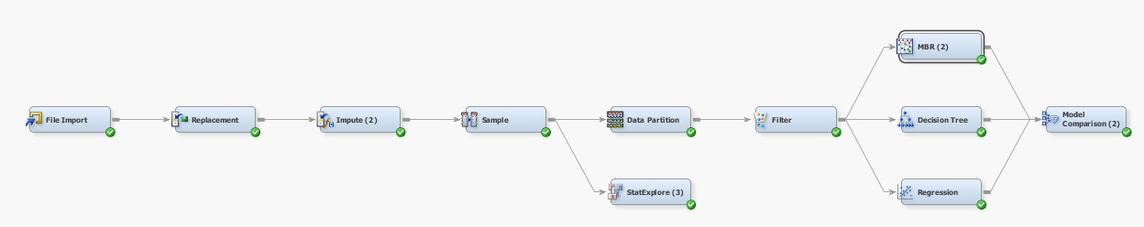
ENTERPRISE MODEL DIAGRAMS

Slide 13
ENTERPRISE MODEL DIAGRAMS
In the replacement node, we have replaced the values of the countries in our data set with the values of the continents in which the countries are present.
In data partition node, we have portioned the data as 80 % training data and 20 % validation set in order to avoid overfitting.
In the impute node, we have imputed the missing values of the seconds elapsed on a site and the number of sessions in the stratified sample.
The filter node is used to remove the records which have NDF and Other in the target.
In the sample node we do stratified sampling of the data and find equal proportion of data based on the target variable. The stratified sample helps us to overcome the problem of predicting the target as we have very diverse pools of data based on target variable.

Slide 14
MODEL COMPARISON
MODEL | TARGET | ACCURACY | TRUE POSITIVE RATE
Base Model MBR | EUR / AUS / N AMERICA | 63.50% | 0.90%
Stratified Sample + MBR | EUR / AUS / N AMERICA | 78% | 99%
Stratified Sample + MBR | 12 Countries | 80% | 0.13%

Slide 15
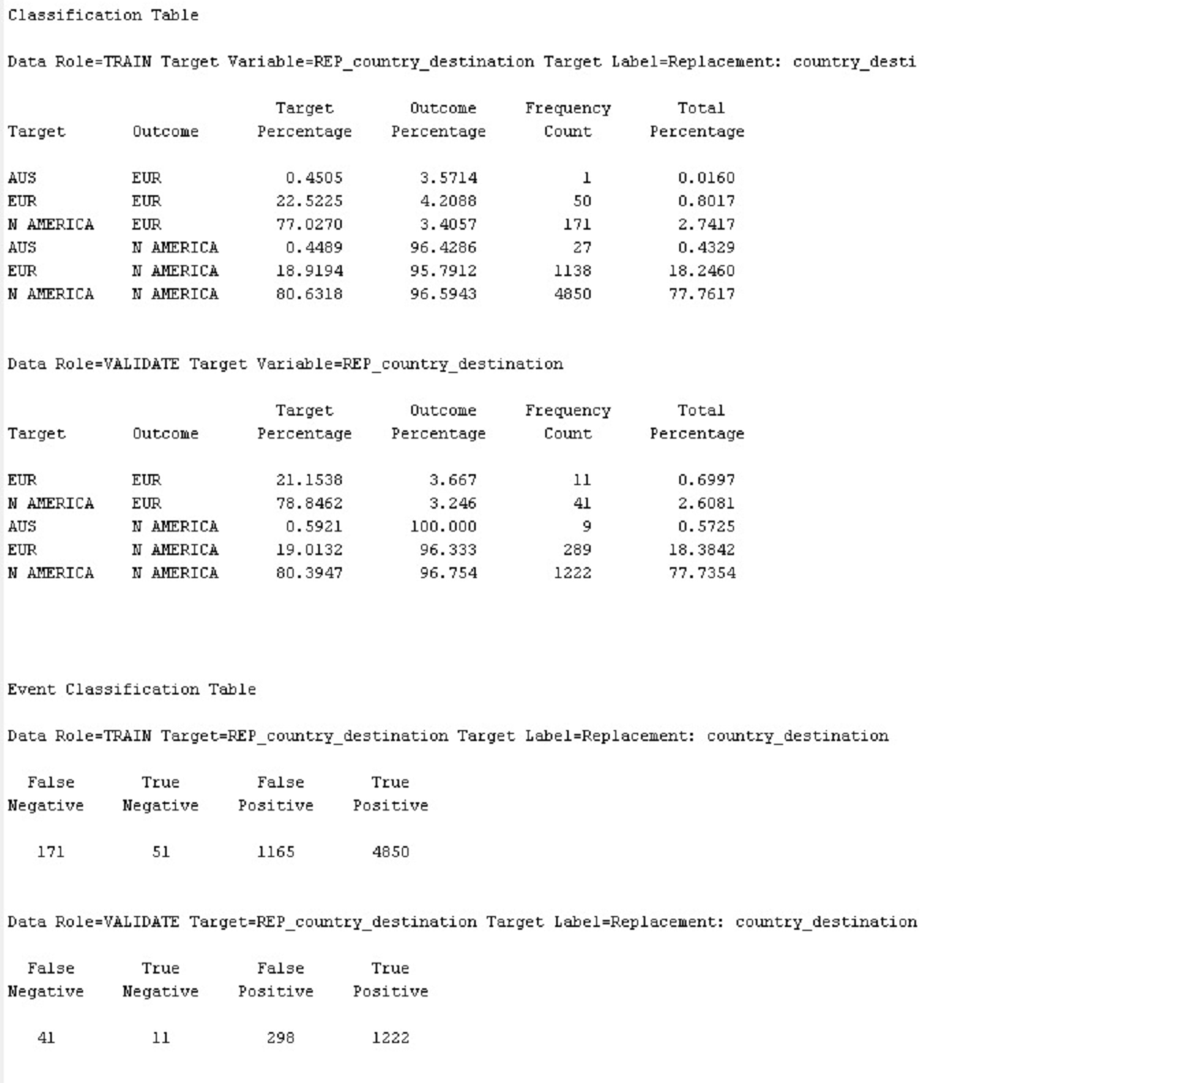
INSIGHTS

Slide 16
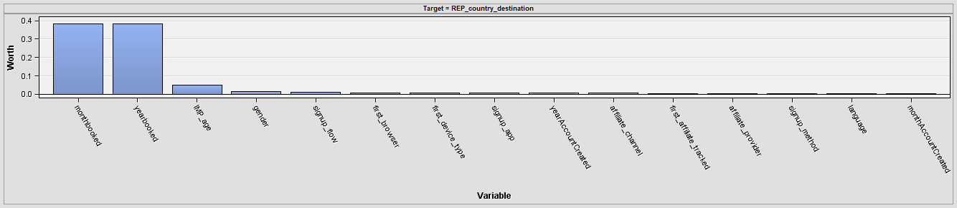
INSIGHTS

Slide 17
INSIGHTS
The month of the booking and the year of booking have the maximum weight followed by age and gender.
So for a new user Airbnb could give its customers a better deals during the months with maximum bookings.

Slide 18
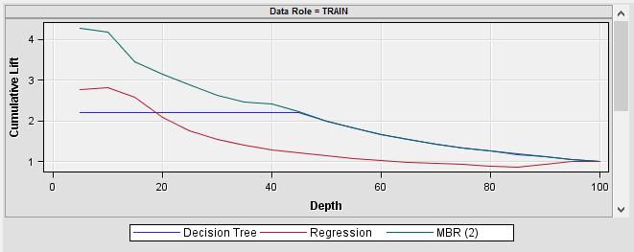
INSIGHTS

Slide 19
INSIGHTS
The chart depicts that the Decision tree model has the least misclassification rate. On closer look into the decision tree model it was observed that the criteria for split was made as missing values and non- missing values and that gave the best information gain which was not meaningful.
The model we have selected is the Memory Based Reasoning (k-closest neighbours) as it takes into consideration the destinations of individuals who have already used airbnb in the past, if the new customer is similar to the previous customers then there is a good possibility he will pick a similar destination.

Slide 20
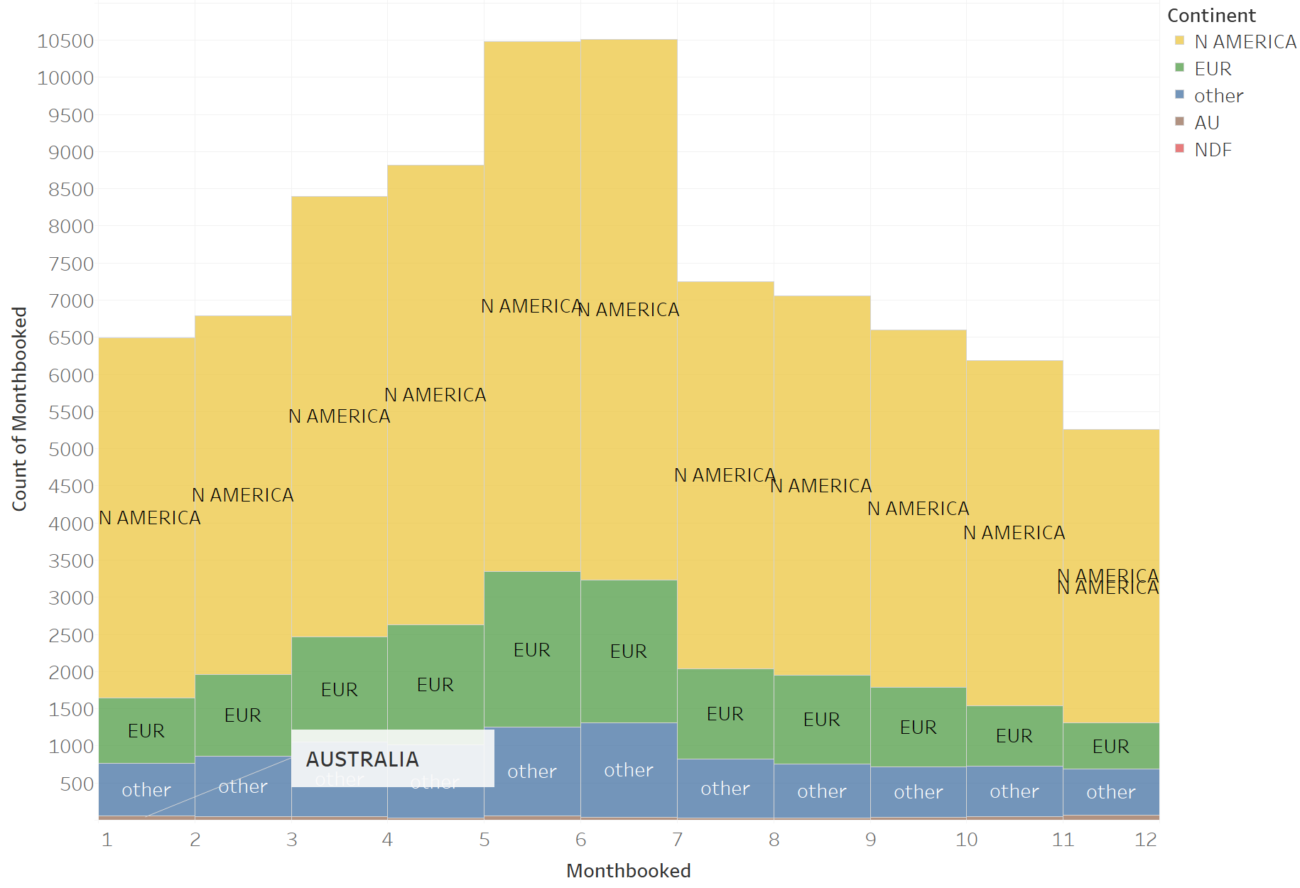
BUSINESS SIGNIFICANCE
Notes:
Month based booking analysis based on past data done using Tableau

Slide 21
BUSINESS SIGNIFICANCE
By accurately predicting where the New User will book their first travel, Airbnb can
Share more personalized content with their community
Decrease the average time to first booking thereby improving user experience
Better forecast demand as per the current trend, based on age, gender and month of booking for the user.

Slide 22
QUESTIONS?

